Slide 1

Web Proxy
Huang Hao, Zhou Yitong, Meng Yu, Chen Zijie, Wen Tianshu
2024.11.29

Slide 2
CONTENTS
Introduction of web server
01 Introduction
Divide of tasks
02 client
CONTENTS
03 server
04 Test
Version control
05 Conclusion
Summarize functional implementations

Slide 3
01
PART
Introduction

Slide 4






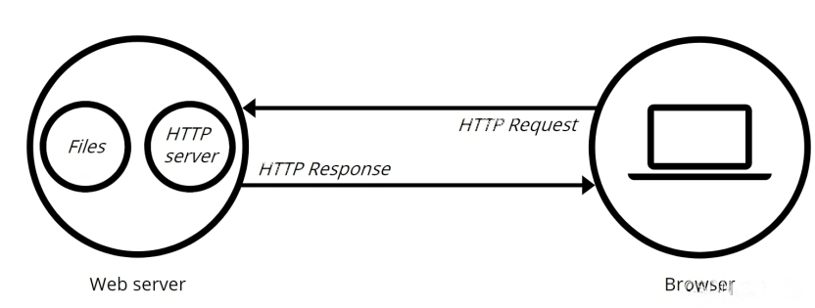

Prepare
client&server
proxy
test
conclusion
Web Server working flow
Client
Steps
①Connect to each other
②Communicate with each other

Slide 5
Prepare
client&server
proxy
test
conclusion
Web Server working flow
Client
Steps
①Connect to each other
②Communicate with each other

Slide 6
Prepare
client&server
proxy
test
conclusion
Web Server working flow
Client
Steps
①Connect to each other
②Communicate with each other

Slide 7
Prepare
client&server
proxy
test
conclusion
Division of tasks
Huang Hao
Getting through the code framework
UI design
safety config design
Windows testing
Wen Tianshu
server design
log safety
rate control
Zhou Yitong
Beautify output
Task framework design
test_client design
Chen Zijie(presentor)
concurrent control
muti-file construction
test_client design
Meng Yu
client design
Functional testing
test_client design

Slide 8
02
PART
client&server

Slide 9


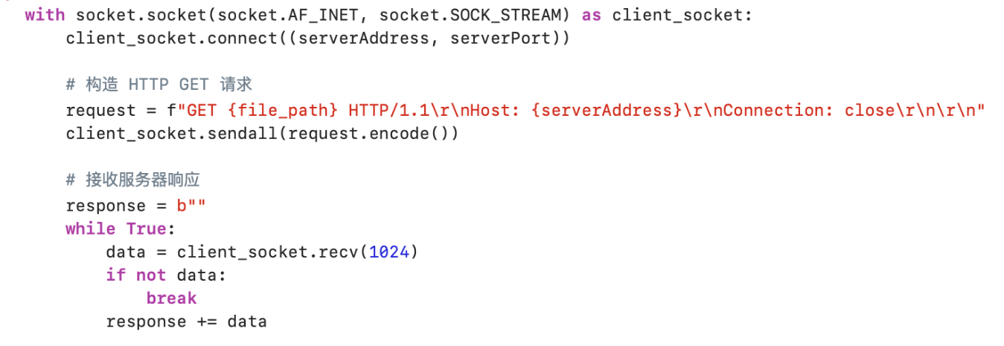
Prepare
client&server
proxy
test
conclusion
send request
Establish a TCP connection:
Create a TCP socket client socket, using AF_INET for the IPv4 address and SOCK_STREAM for the TCP connection. Use the with statement to ensure that the client socket is automatically closed after use.
Connect to the specified server address and port.
Construct and send the request: Construct a simple HTTP GET request with the file path specified by the file_path parameter. The request contains the HTTP/1.1 protocol version, the Host address host, and the Connection: close field (indicating that the connection is closed when the request is complete). The request is then sent to the server via the socket.
Receive data: Initializes an empty byte response to store the data returned by the server. Enter the while loop, receiving up to 1024 bytes of data at a time from the server

Slide 10
Prepare
client&server
proxy
test
conclusion
send request
Establish a TCP connection:
Create a TCP socket client socket, using AF_INET for the IPv4 address and SOCK_STREAM for the TCP connection. Use the with statement to ensure that the client socket is automatically closed after use.
Connect to the specified server address and port.
Construct and send the request: Construct a simple HTTP GET request with the file path specified by the file_path parameter. The request contains the HTTP/1.1 protocol version, the Host address host, and the Connection: close field (indicating that the connection is closed when the request is complete). The request is then sent to the server via the socket.
Receive data: Initializes an empty byte response to store the data returned by the server. Enter the while loop, receiving up to 1024 bytes of data at a time from the server

Slide 11
03
PART
server

Slide 12





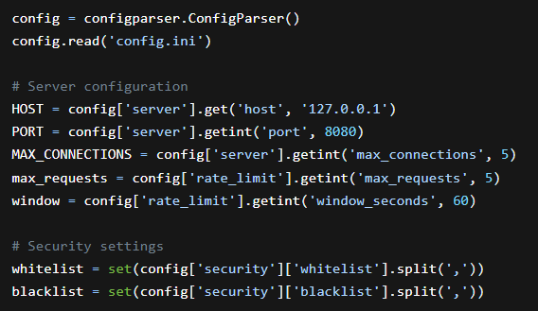
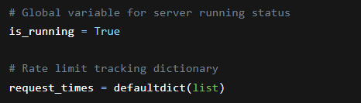
Prepare
client&server
proxy
test
conclusion
Configuration Reading and Global Variables
Configuration File Reading
1. Create a configparser.ConfigParser() instance and read the config.ini file.
2. Retrieve server configuration:
Get the HOST from the [server] section, defaulting to 127.0.0.1.
Get the PORT from the [server] section, defaulting to 8080.
Get the MAX_CONNECTIONS from the [server] section, defaulting to 5.
3. Read rate - limiting configuration:
Get the max_requests from the [rate_limit] section, defaulting to 5.
Get the window from the [rate_limit] section, defaulting to 60 seconds.
4. Load security settings:
Create the whitelist by splitting the [security] section's whitelist parameter.
Create the blacklist by splitting the [security] section's blacklist parameter.
Global Variable Explanation
1. The key global variable is_running is used to control the server's running status.
2. The request_times dictionary is used to track client request times for rate limiting.

Slide 13
Prepare
client&server
proxy
test
conclusion
Configuration Reading and Global Variables
Configuration File Reading
1. Create a configparser.ConfigParser() instance and read the config.ini file.
2. Retrieve server configuration:
Get the HOST from the [server] section, defaulting to 127.0.0.1.
Get the PORT from the [server] section, defaulting to 8080.
Get the MAX_CONNECTIONS from the [server] section, defaulting to 5.
3. Read rate - limiting configuration:
Get the max_requests from the [rate_limit] section, defaulting to 5.
Get the window from the [rate_limit] section, defaulting to 60 seconds.
4. Load security settings:
Create the whitelist by splitting the [security] section's whitelist parameter.
Create the blacklist by splitting the [security] section's blacklist parameter.
Global Variable Explanation
1. The key global variable is_running is used to control the server's running status.
2. The request_times dictionary is used to track client request times for rate limiting.

Slide 14
Prepare
client&server
proxy
test
conclusion
Configuration Reading and Global Variables
Configuration File Reading
1. Create a configparser.ConfigParser() instance and read the config.ini file.
2. Retrieve server configuration:
Get the HOST from the [server] section, defaulting to 127.0.0.1.
Get the PORT from the [server] section, defaulting to 8080.
Get the MAX_CONNECTIONS from the [server] section, defaulting to 5.
3. Read rate - limiting configuration:
Get the max_requests from the [rate_limit] section, defaulting to 5.
Get the window from the [rate_limit] section, defaulting to 60 seconds.
4. Load security settings:
Create the whitelist by splitting the [security] section's whitelist parameter.
Create the blacklist by splitting the [security] section's blacklist parameter.
Global Variable Explanation
1. The key global variable is_running is used to control the server's running status.
2. The request_times dictionary is used to track client request times for rate limiting.

Slide 15
04
PART
Testing

Slide 16





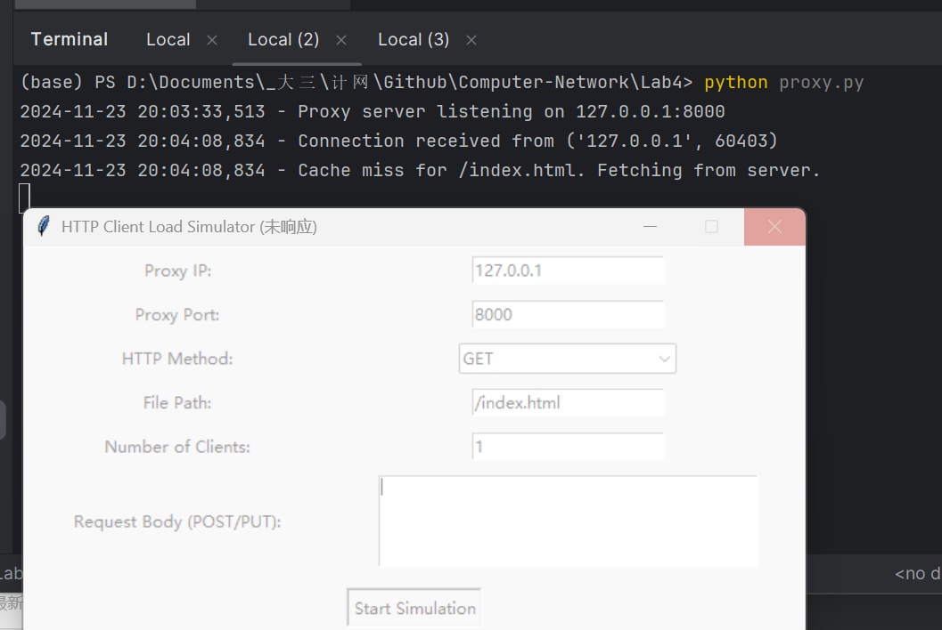
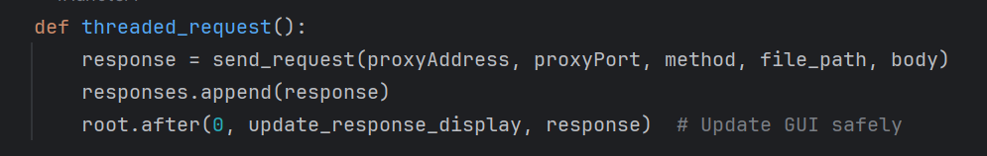
introduction
client
server
test
conclusion
Multiple problems have been solved
1. client.py can’t reply: The main thread is blocked
Possible Solution:
thread.join()
root.after()
Update the response_display asynchronously to ensure that the UI doesn't get stuck with data writes

Slide 17
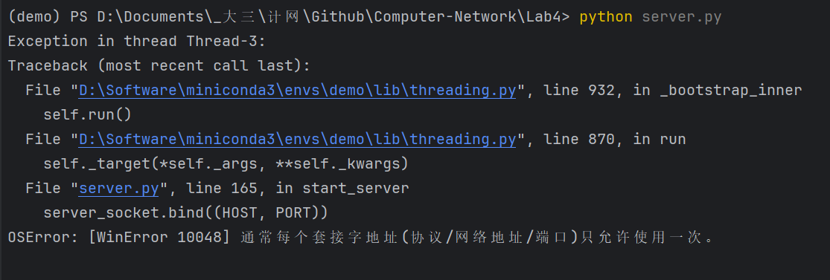
introduction
client
server
test
conclusion
Multiple problems have been solved
2. Socket parameter error:
Possible Solution:
Change the web server or proxy port

Slide 18
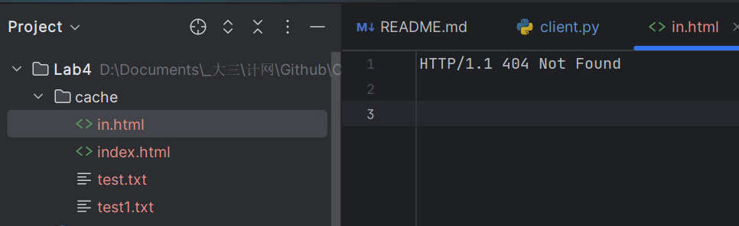
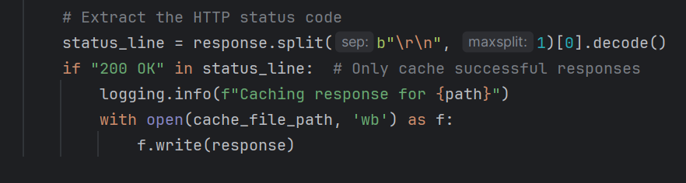
introduction
client
server
test
conclusion
Multiple problems have been solved
3. Unexpected storage in cache:
Possible Solution:
We only want to store the acessable file.
Add a new condition:

Slide 19
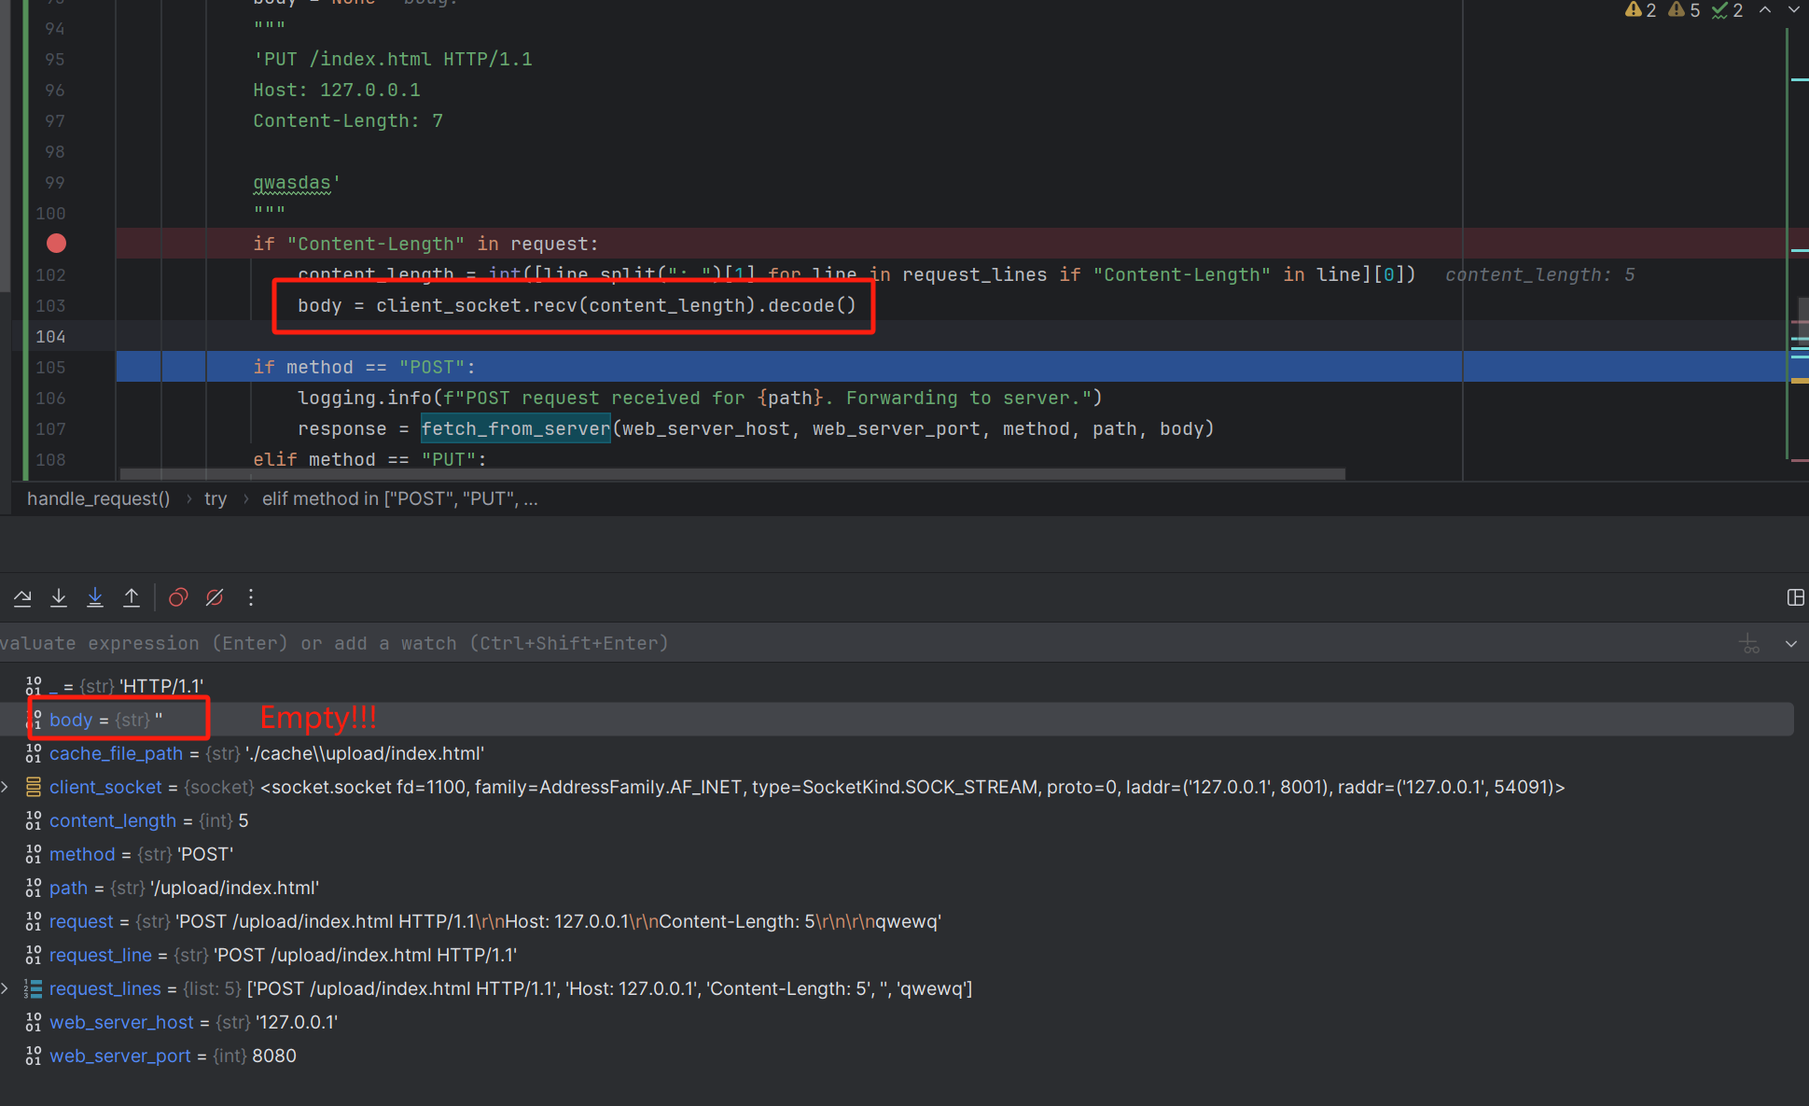
introduction
client
server
test
conclusion
Multiple problems have been solved
4. Post unsccessfully:

Slide 20
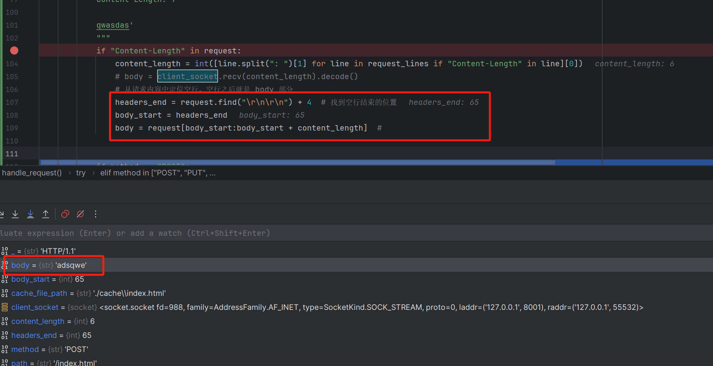
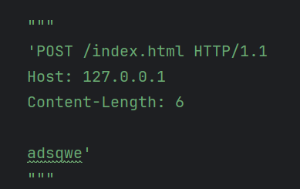
introduction
client
server
test
conclusion
Multiple problems have been solved
4. Post sccessfully:

Slide 21
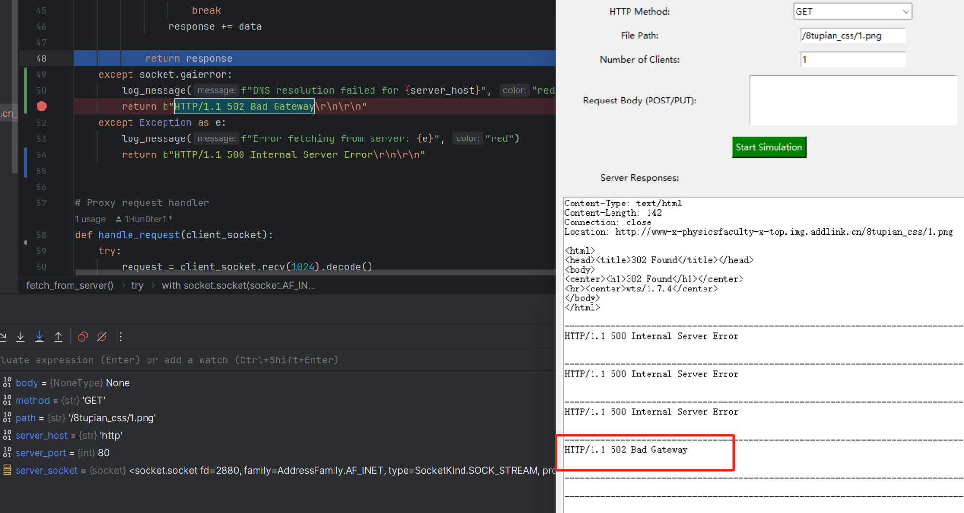
introduction
client
server
test
conclusion
Multiple problems have been solved
5. DNS resolution failed:

Slide 22
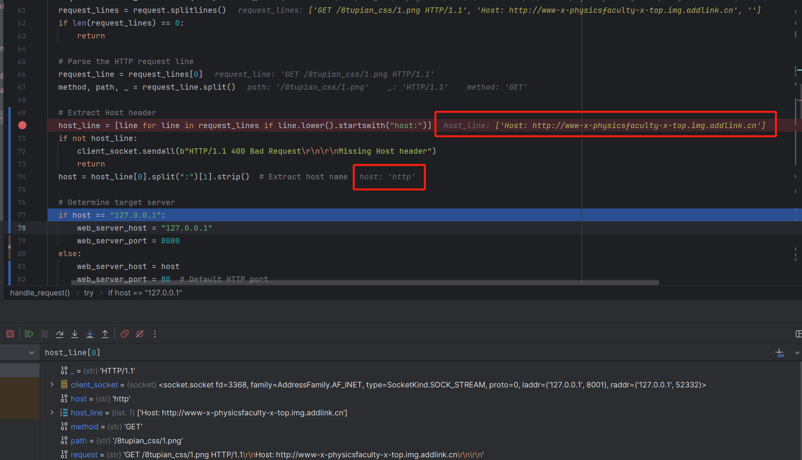
introduction
client
server
test
conclusion
Multiple problems have been solved
5. DNS resolution failed:

Slide 23
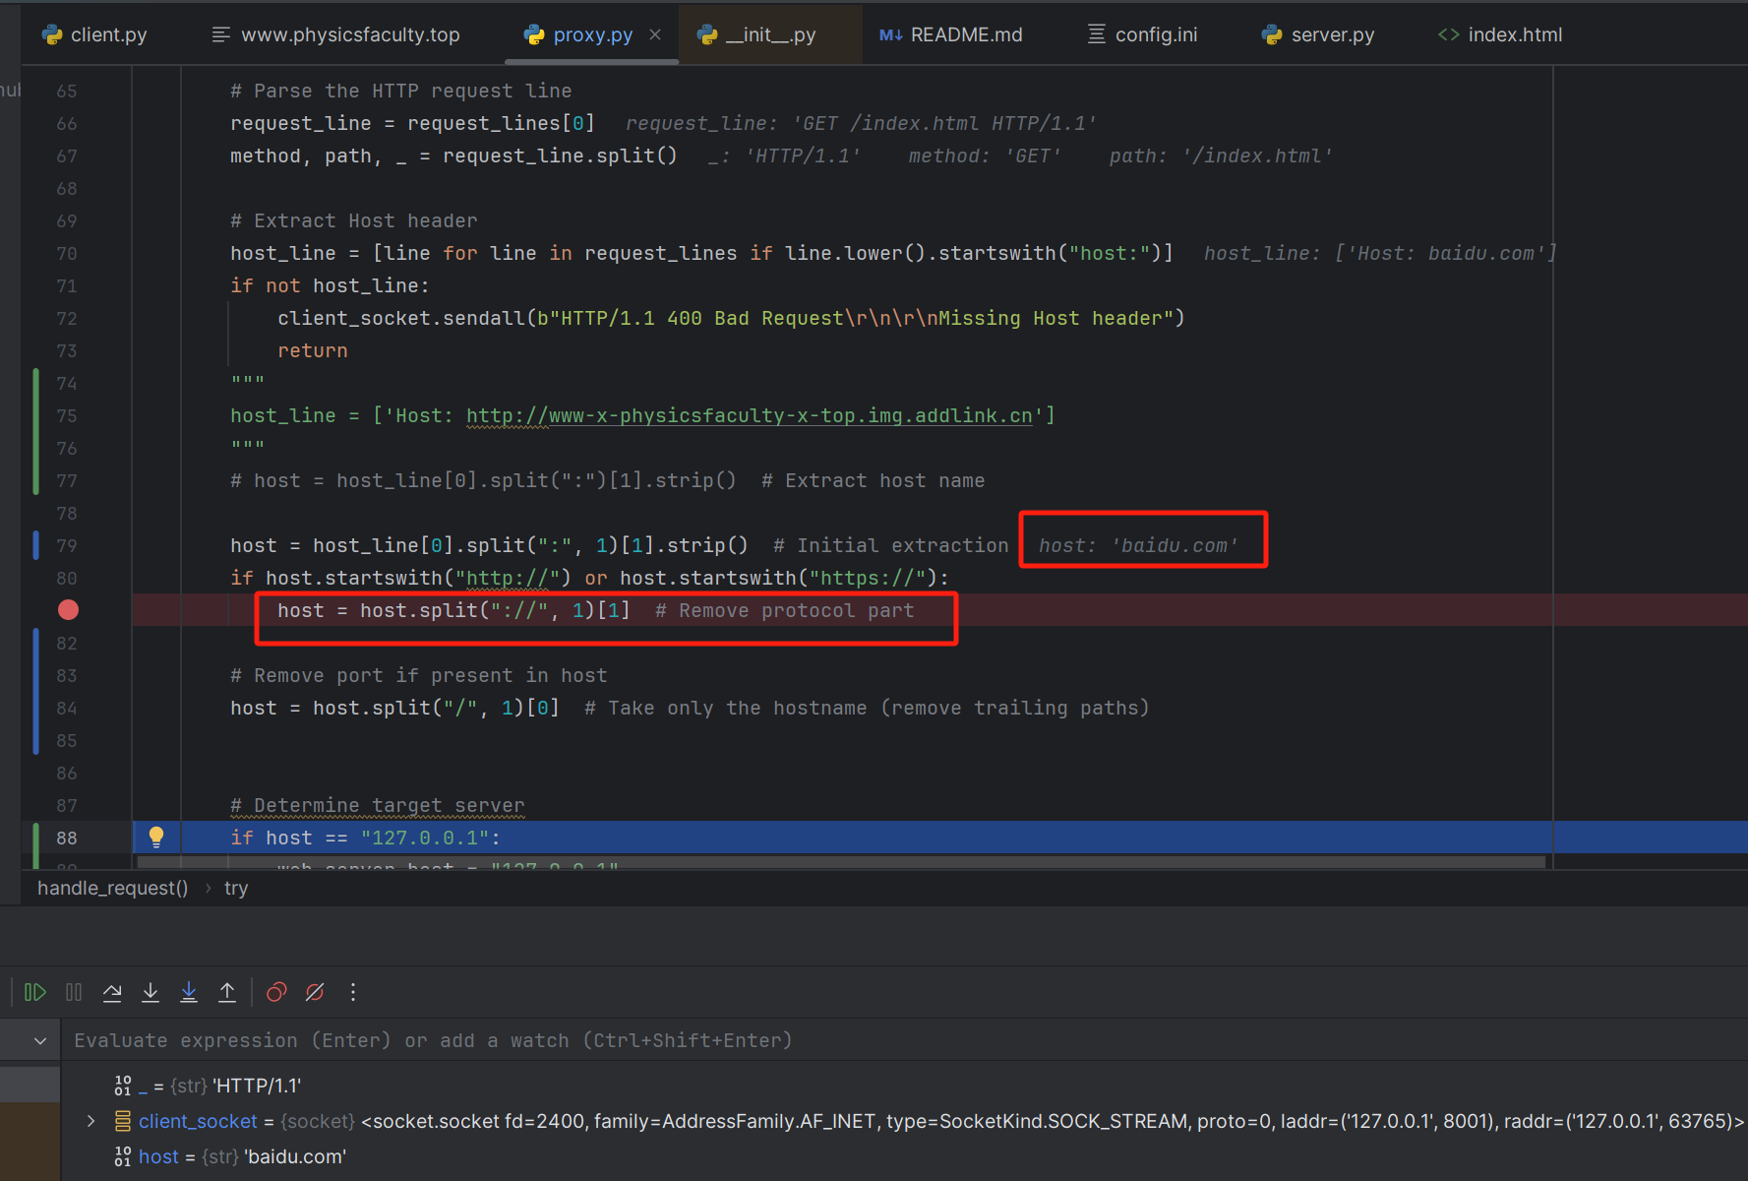
introduction
client
server
test
conclusion
Multiple problems have been solved
5. DNS resolution successfully:

Slide 24
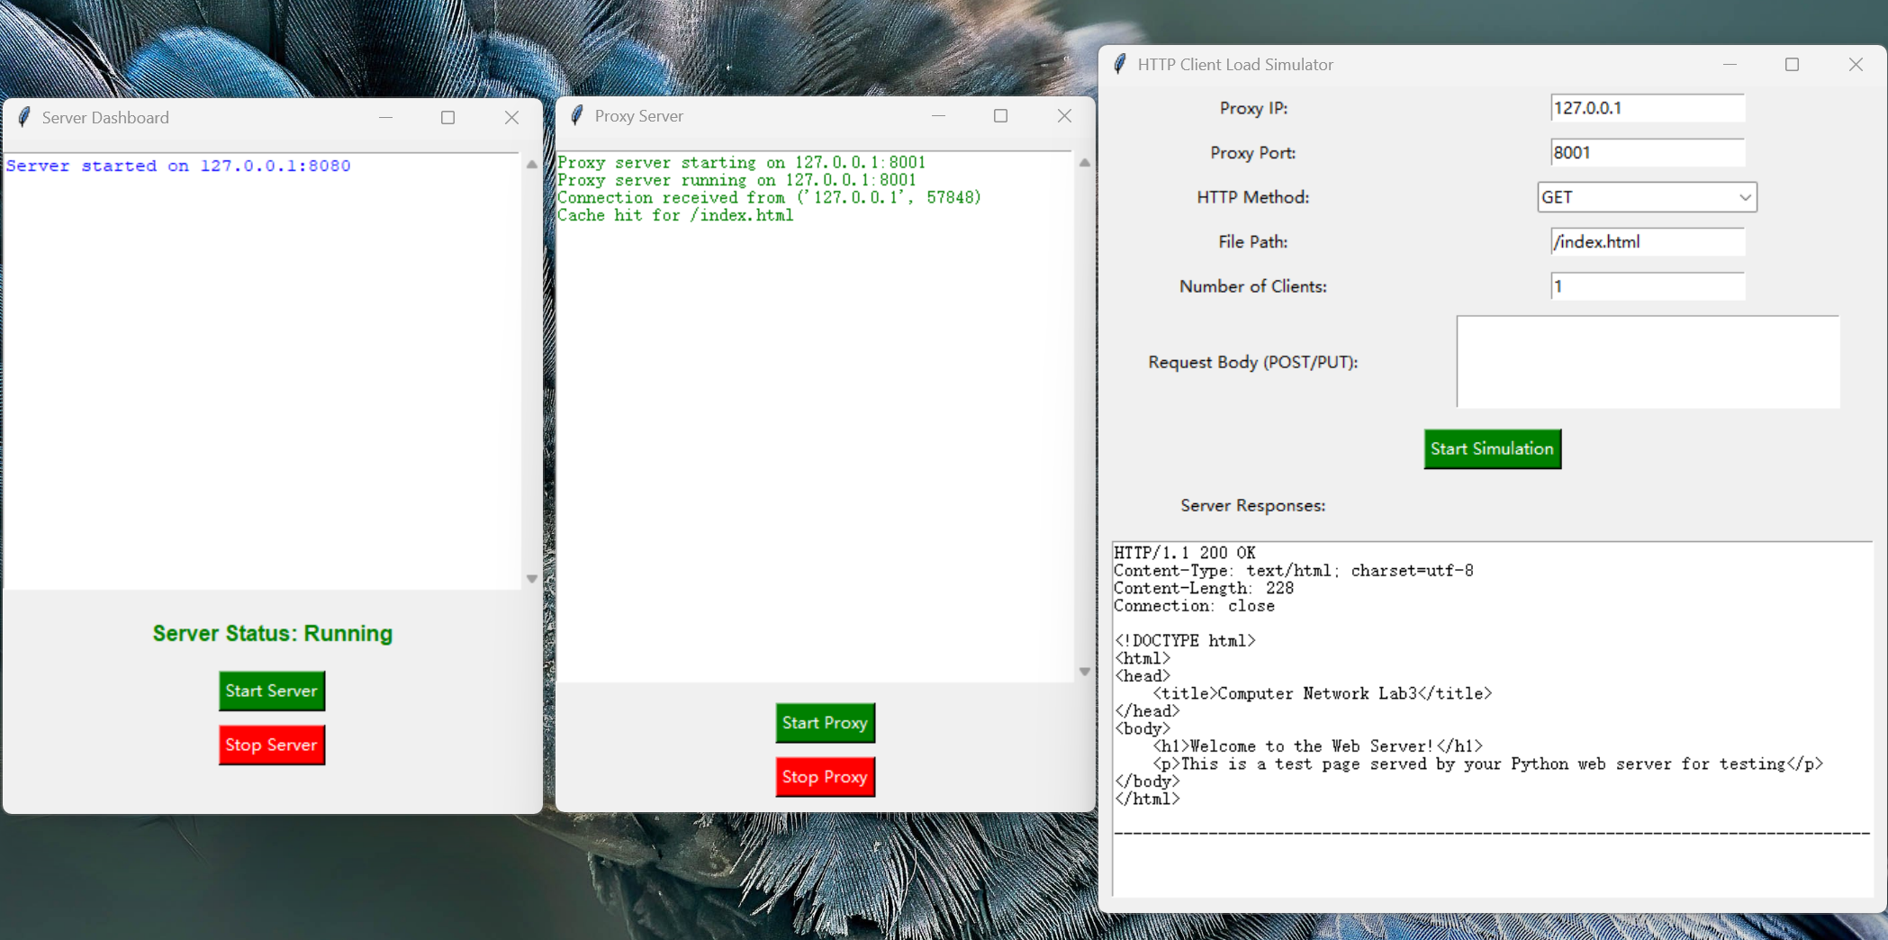
introduction
client
server
test
conclusion
Show the result
get method

Slide 25
05
PART
Conclusion

Slide 26


prepare
client
server
test
conclusion
From Lab1 to Lab4
README.md
9 files
config.ini, server.log
8 histories
5 collaborators

Slide 27
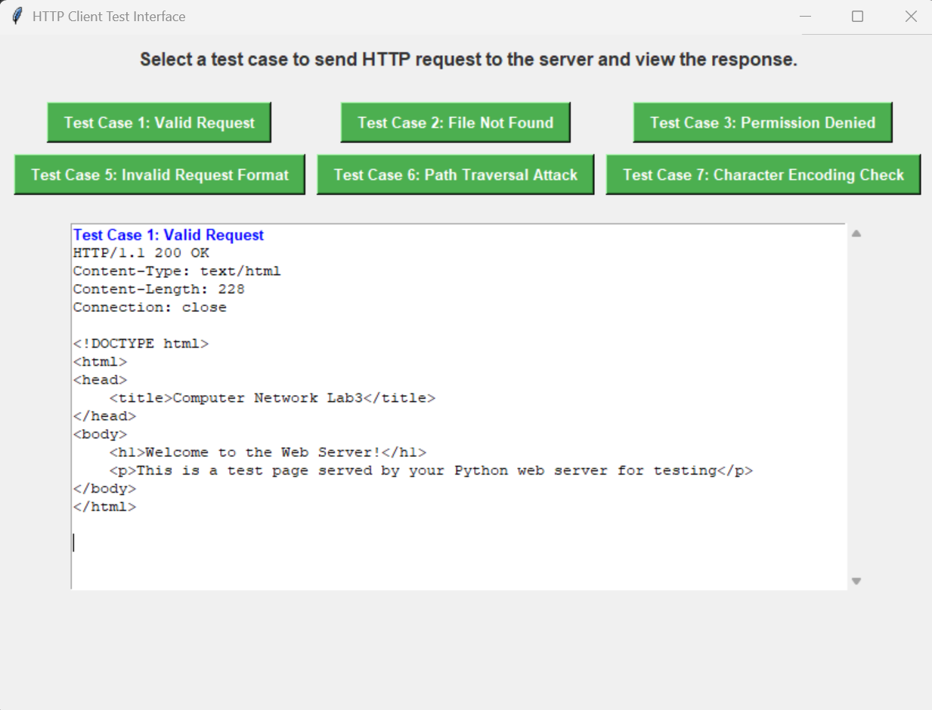
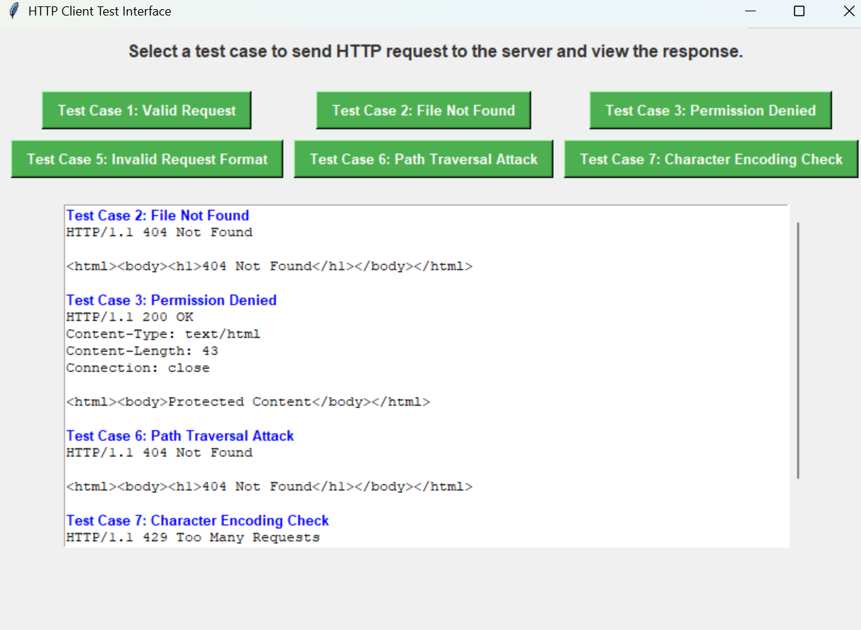
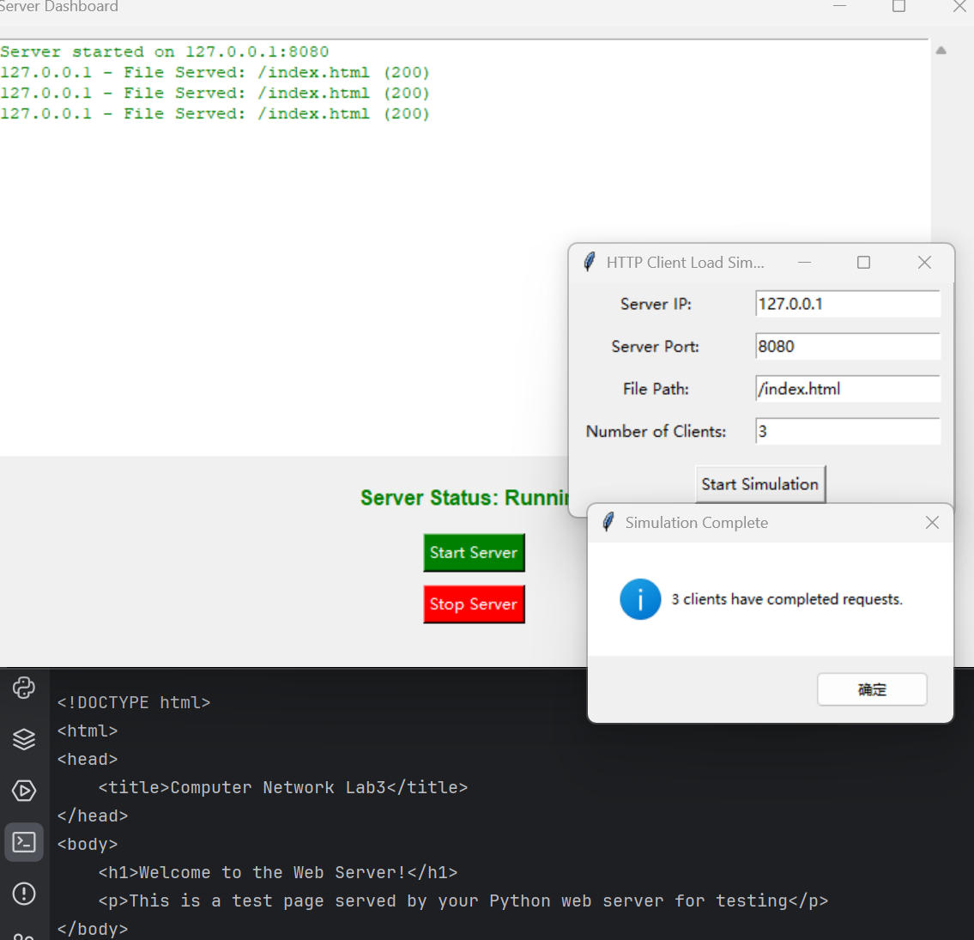
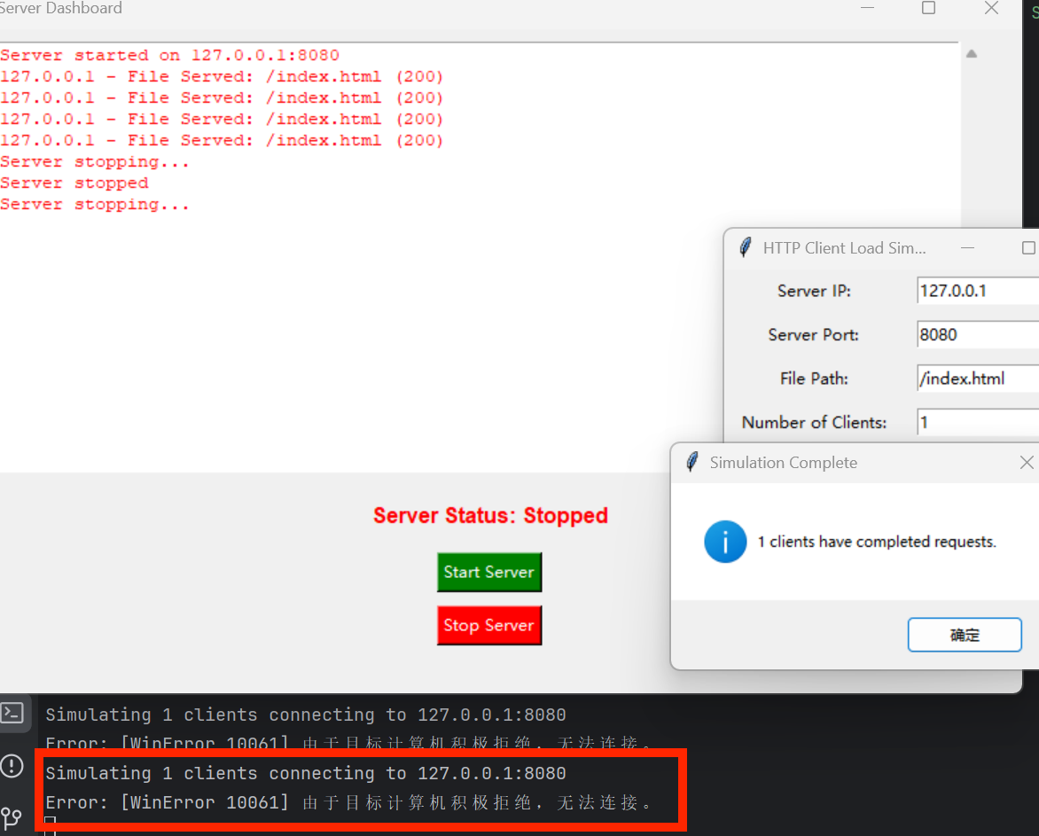
prepare
client
server
test
conclusion
Summary of all functional implementations
Simulation of server & client
Multithreading
rate control
safety config design
UI design
log storage(.log)

Slide 28
Thank you!
Huang Hao, Zhou Yitong, Meng Yu, Chen Zijie, Wen Tianshu
2024.11.29

